Slide 1
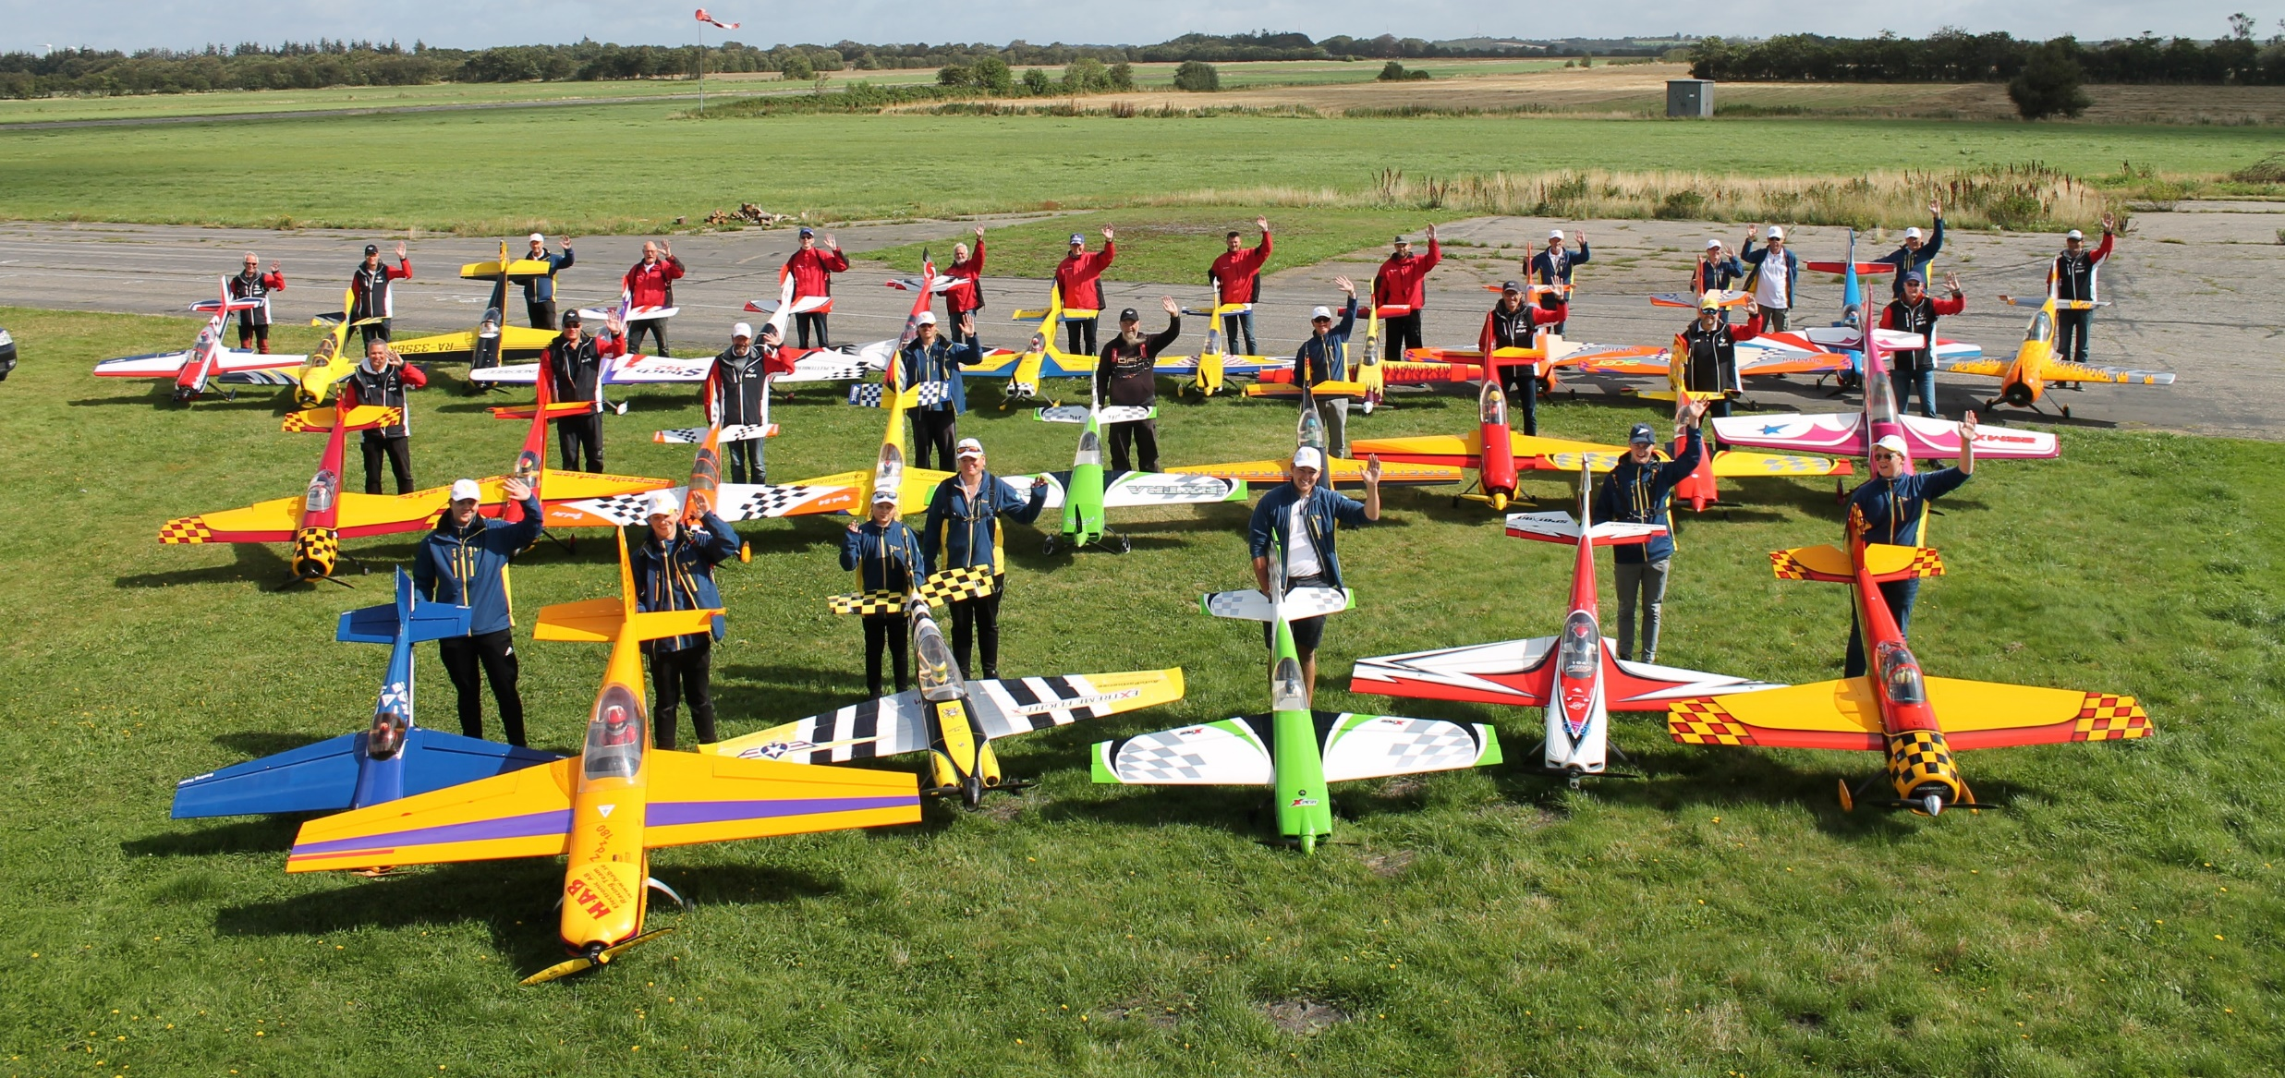
IMAC NORDICS 2019
LINDTORP

Slide 2
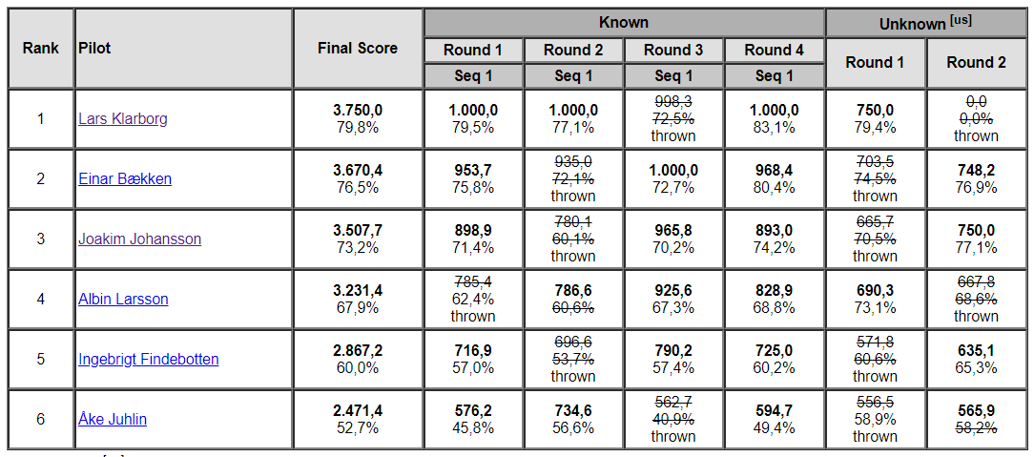
BASIC

Slide 3
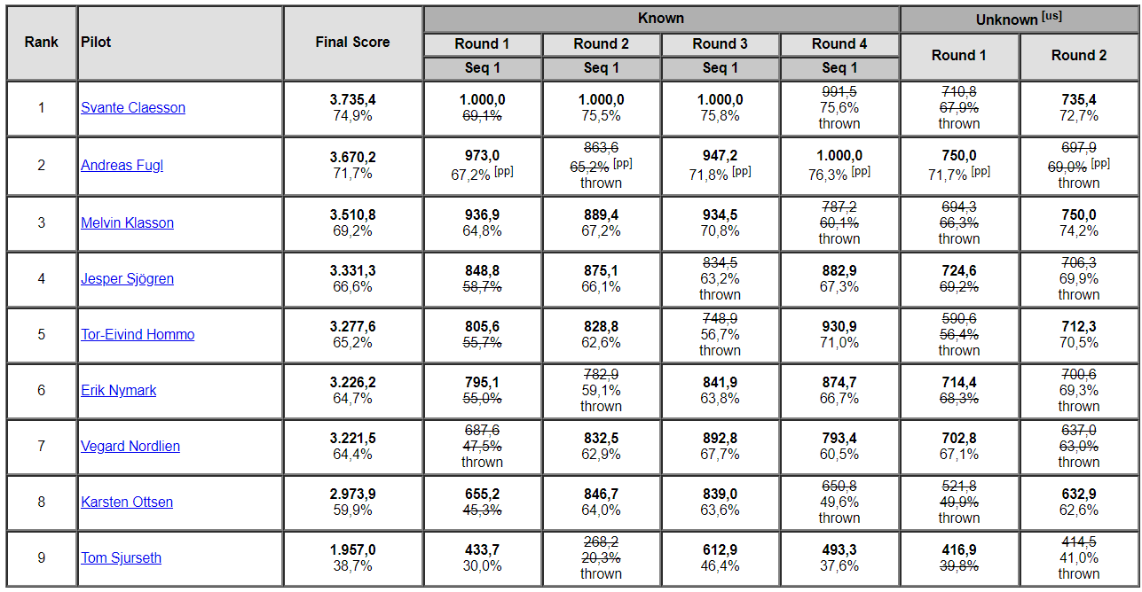
SPORTSMAN

Slide 4
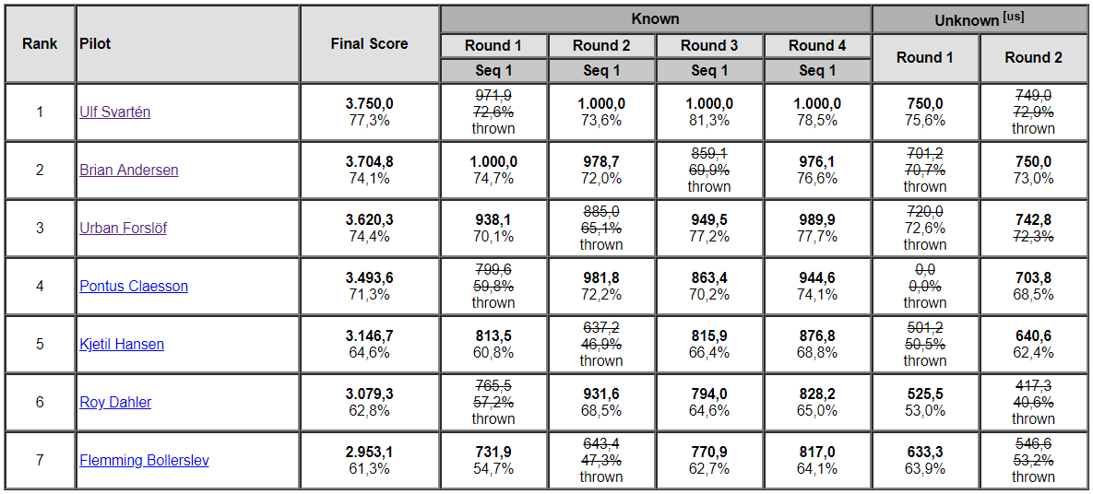
INTERMEDIATE

Slide 5
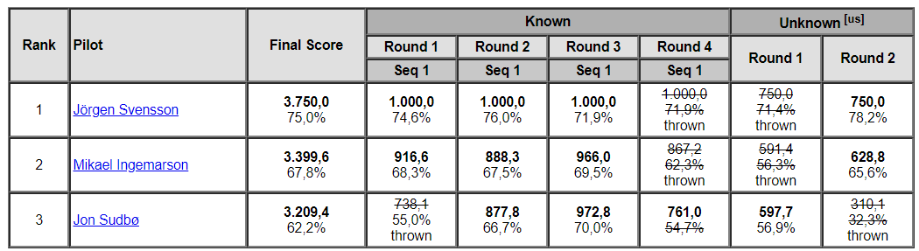
ADVANCED

Slide 6
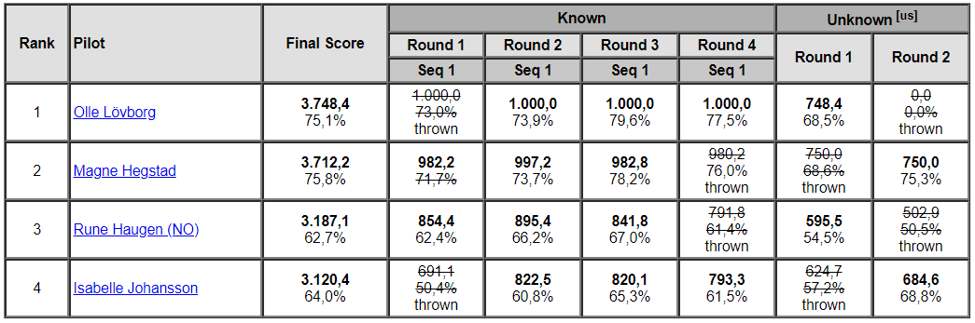
UNLIMITED

Slide 7
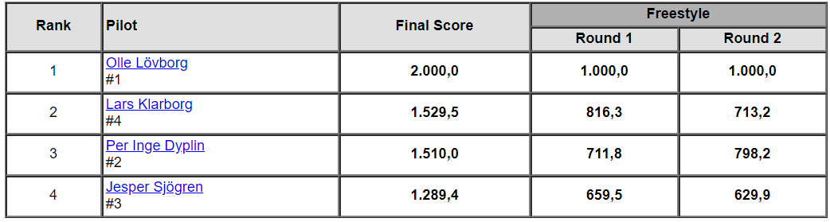
FREESTYLE

